Slide 1
01: Preliminaries
MerceEnergy.com
11-29-2018

Slide 2

Objectives
The goal is to become experts in battery electronics. The team needs to understand how a battery management system works. Creating schematics, prototyping, and using tools.
A battery management system measures the batteries temperature, the rate of charge and discharge, and much more.
The team will learn by learning Arduino and Raspberry PI.

Slide 3
Firmware Engineering
The biggest difference is that firmware engineers work closer to the hardware on which their software is running. Because of this, a Firmware Engineer tends to have more intimate knowledge of digital circuit design, things like hardware clock signals, timing diagrams, and other such things
http://wiki.c2.com/?FirmwareEngineer

Slide 4
Electronic Engineering
Electronic engineering utilises a variety of different types of electronic components from the more traditional analogue components through to digital electronic components, microprocessors and microcontrollers as well as programmable logic devices. This means that electronic engineering can incorporate a large variety of different areas
https://www.electronics-notes.com/articles/becoming-an-engineer/electronics-engineering/what-is-electronic-engineering.php

Slide 5
What is a microcontroller?
Electrical Appliances such as ovens, toasters, lamps and many more require some computing power.
A microcontroller consists of processors, memory, input and output, all on a chip.
Arduino is an example contains a microcontroller.
The arduino is overpowered as some components may not be used for our purpose.

Slide 6
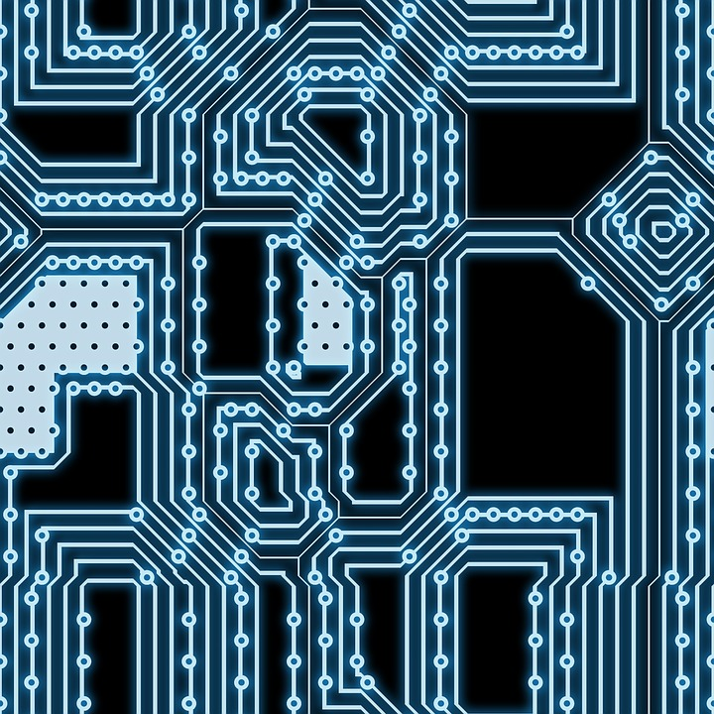
What is a PCB?
Printed Circuit Board
Components such as a capacitor, resistors, transistors, need to be connected in order to create an electronic device, using wires is inefficient.
A PCB connects the components together.
The wiring is integrated into the board.
Create the board → Solder components

Slide 7
Understanding Electricity

Slide 8
Electrical Charge
“The flow of electrons”
Atoms consist of •Protons, Neutrons, Electrons
How electrical charge is measured. (Coulombs C)
1 coulomb = 6.242x10^(18)
Two opposite charged particles they attract.
Two similar charged particles repel.
Gaining electrons makes an object negatively charged.
Losing electrons makes the object positively charged.

Slide 9
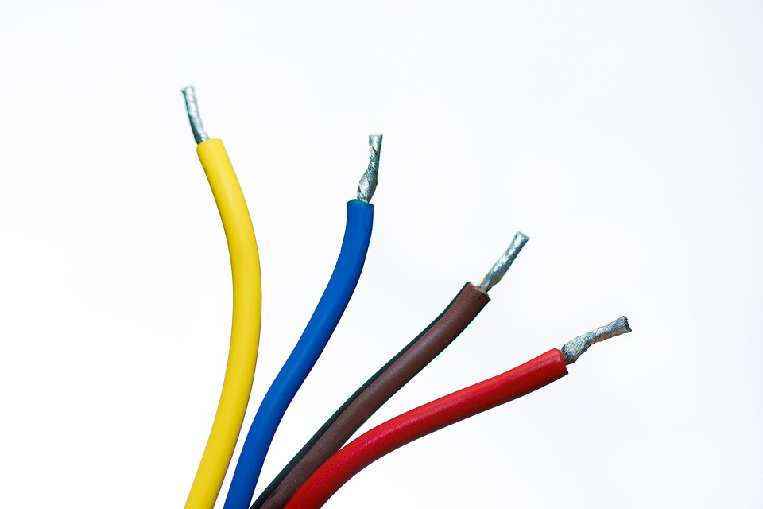
Conductivity
How well electrons move through a “medium”.
Different material allow electrons to move freely, some do not.
Copper and gold are very conductive.
Insulators do not allow electrons to move freely.
Plastic, paper, or rubber.
Temperature may change the conductivity of materials.
Electrical Wire is made of copper encased by plastic.

Slide 10
Voltage
Electric Potential difference between two points.
Produces a force to move to move electrons.
Two different points.
A battery that is 5V.
Ground (GND)
Reference point in an electrical circuit from which voltages are measured.

Slide 11
Current
Electrons : Negative → Positive (Convention)
Flow of electric charge
Connect battery to a wire, and electrons will flow. This will create a short unless the wire is connected to an electrical device.
Measured in units of Ampere.
1 Ampere = 1 Coulomb/Second
Voltage makes electrons flow. The flow of electrons is the current.
Think of a hose.
Current flows from positive to negative.

Slide 12
Circuit
A pathway for electrons.
Battery is like a pump.
What makes a circuit ?
Voltage or Current Source (Battery)
Electric load (What consumes those electrons? Light Bulb, Electronic)
Open circuits stop flow of current. (A switch)
Closed circuit, referred to as short circuits, electrons flow continuously.
Short circuit allows excessive amount of current to flow.
Electrons take the path of least resistance.

Slide 13
Formulas: Resistance and Ohms Law
Resistance: How much an object resists electric current (Ohms \Omega)
Ohm’s Law
V = IxR
V = voltage
I = Current
R = Resistance

Slide 14
SI Prefixes
Giga | G | 1000,000,000 | 10^9
Mega| M | 1,000,000 | 10^6
10M is 10x10^6
Kilo | k | 1000 | 10^3
Milli | m | .001 | 10^(-3)
Micro |mu | .000 001 | 10^(-6)
Nano | n | .000 000 001 | 10^(-9)
Pico | p | .000 000 000 001 | 10^(-12)

Slide 15
LED
Light Emitting Diode
Has very small resistance.
It will burn out if gets to much current.
Adding a resistor may limit the amount of current.
It also has a voltage drop across it.

Slide 16
Thank You
Ramiro Gonzalez
ramirogonzalez@mercedenergy.com
ramirogonzalez.org
MercedEnergy.com
209-962-2524

